Slide 1
Hello! Group 3: Christian Frans Mukuan Deyaninta Ekabriela Permata Mufadhal Faraz Addhifa

Slide 2
The Topic We Talk About
Virtual Memory in Windows 10

Slide 3
Agenda
Describes definition of Operating System
Describes definition of Windows 10
Describes definition of Memory
Describes definition of Virtual Memory
Describes steps to manually set page file in Windows 10
Describe steps to change the location a page file in Windows 10
Conclusion and Suggestion

Slide 4
What is
Operating System
Notes:
Operating System / OS is software with the task of controlling and managing hardware as well as basic system operation, including running application software such as data processing program that can be used to facilitate human activity.

Slide 5
What is
Windows 10
Notes:
Windows 10 is a series of a personal computer operating system produced by Microsoft as a part of it’s Windows NT Family of Operating System.

Slide 6
What is
Memory ?
Notes:
Memory (or more accurately called physical memory) is a generic term that refers to temporary data storage media on a computer. Data stored in physical memory is temporary because the data stored in it will be stored as long as the computer is still powered (in other words, the computer is still alive).

Slide 7
What is Virtual Memory?
Notes:
> Christ

Slide 8
Steps to Manually Set Page File In Windows 10
Notes:
> Fadhal

Slide 9
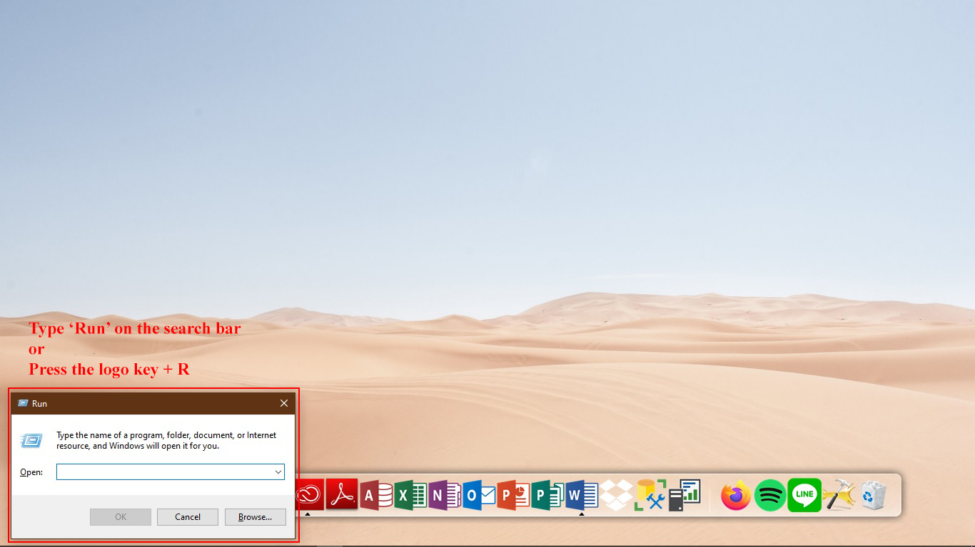
1
Notes:
First, user can type ‘Run’ on the search bar or can using logo key + R, and the Run application will be show in user desktop

Slide 10

2
Notes:
Next, type ‘SystemPropertiesAdvanced’ and click OK button

Slide 11
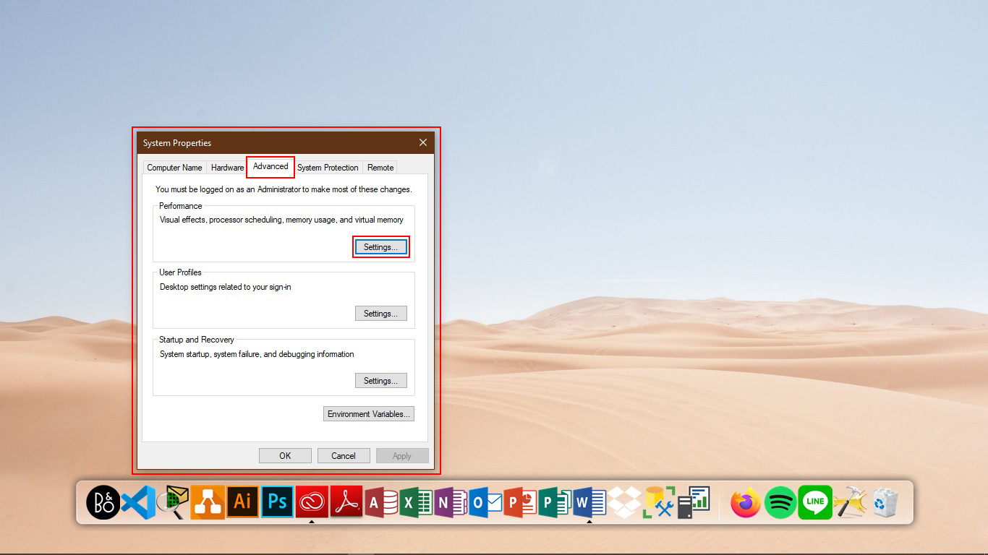
3
Notes:
Window of System Properties will be show in user desktop and click setting button in performance option

Slide 12
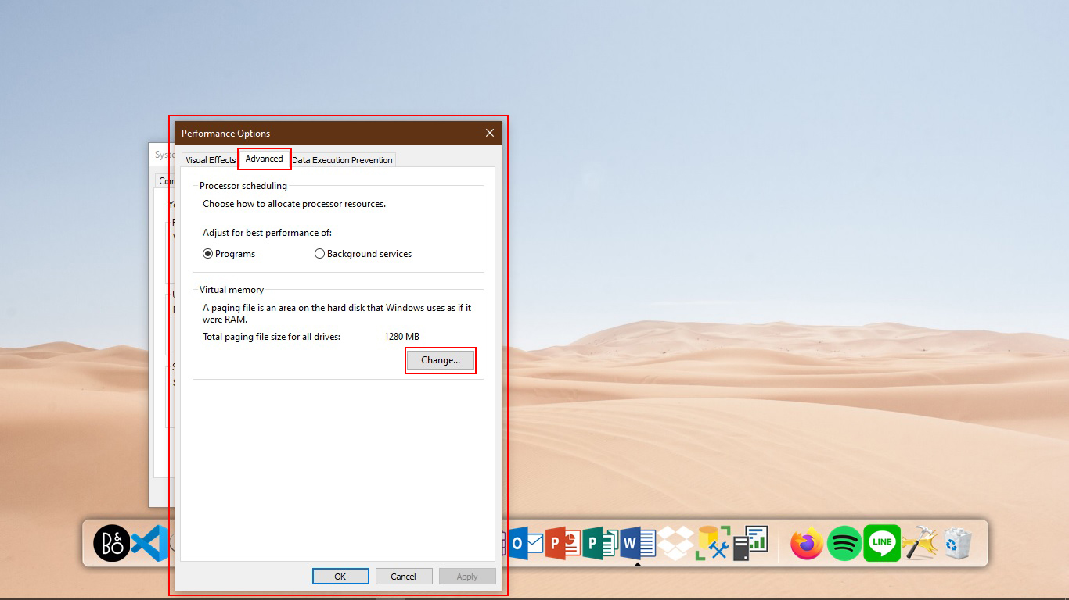
4
Notes:
Window of Performance option will be show in user desktop, click Change button in Virtual Memory option

Slide 13
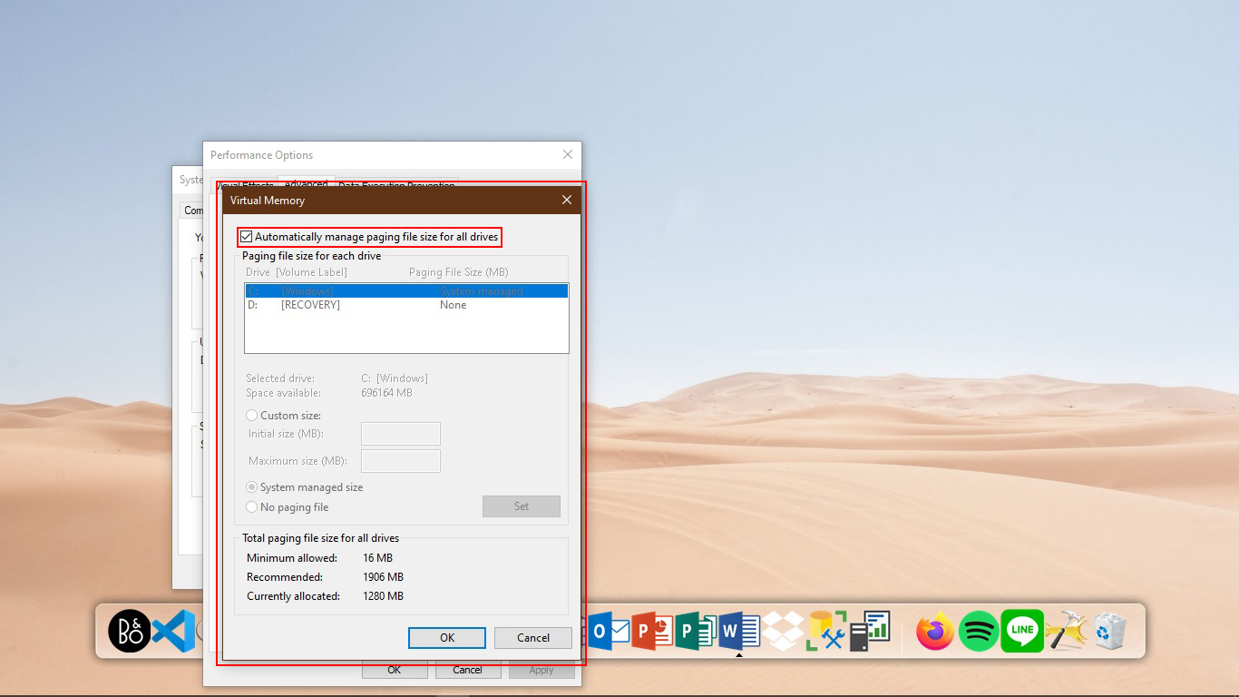
5
Notes:
Window of Virtual Memory will be show in user desktop, and uncheck in Automatically manage paging file size for all device

Slide 14
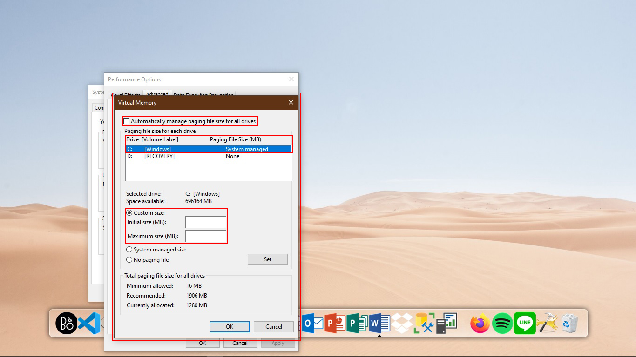
5.1
Notes:
Select the partition and fulfill in Initial size and maximum size.

Slide 15
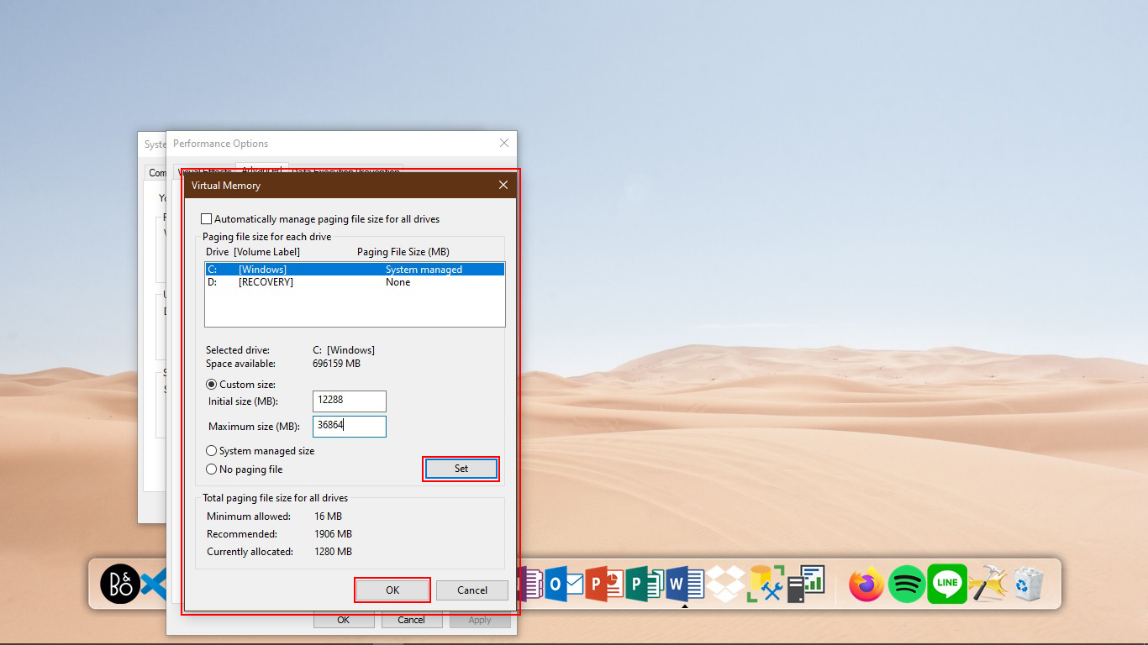
6
Notes:
The size of Virtual memory is unique to each device and it can’t be generalized. However usually it’s recommended to used a number that one and a half times (1.5x) that the total available memory for ‘Initial Size’ and three times (3x) for ‘Maximum Size’ when possible. And click Set and OK button

Slide 16
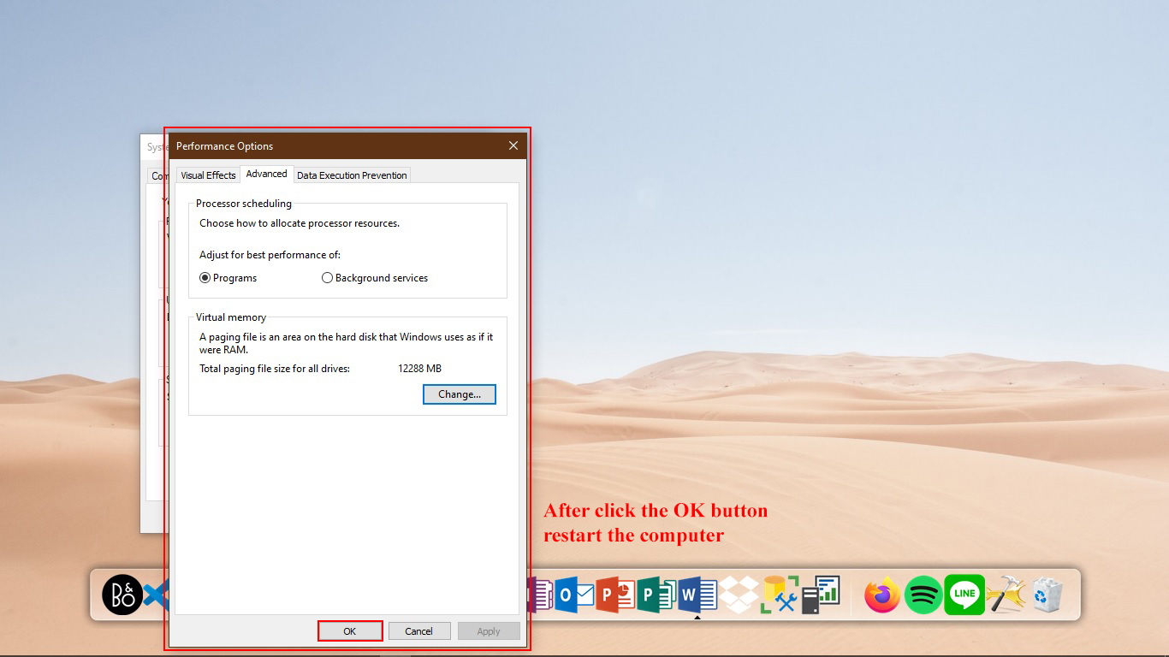
7
Notes:
Click OK button again, and restart a computer

Slide 17
Steps to Change the Location of page file
Notes:
> Deya

Slide 18
1
Notes:
Open the Run application by typing "Run" in the search box in the left corner of the Taskbar

Slide 19
2
Notes:
Type : SystemPropertiesAdvanced

Slide 20
3
Notes:
The System Properties window will appear, in the Performance section click Settings

Slide 21
4
Notes:
The System Performance Options window will appear, click Change in the Virtual memory selection in the Advance tab

Slide 22
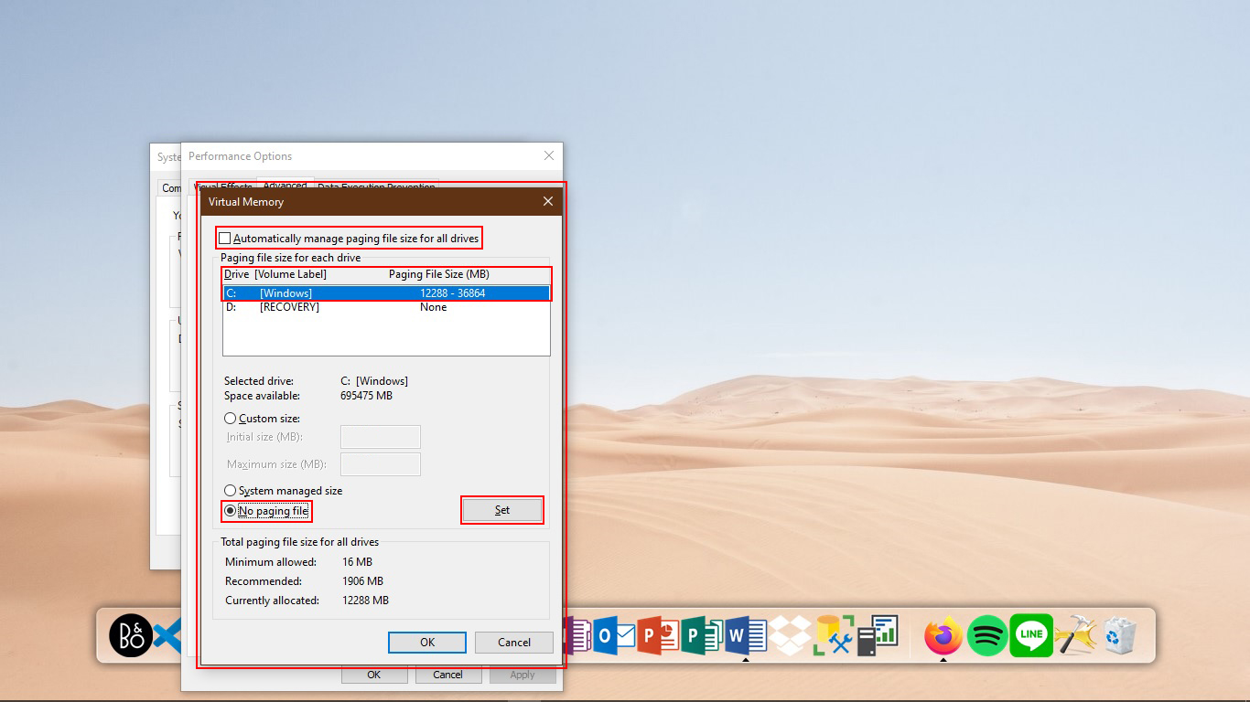
5
Notes:
Uncheck the Automatically manage paging file size for all drives option. Choose the default location of page file and select the No paging file button and click the Set button

Slide 23
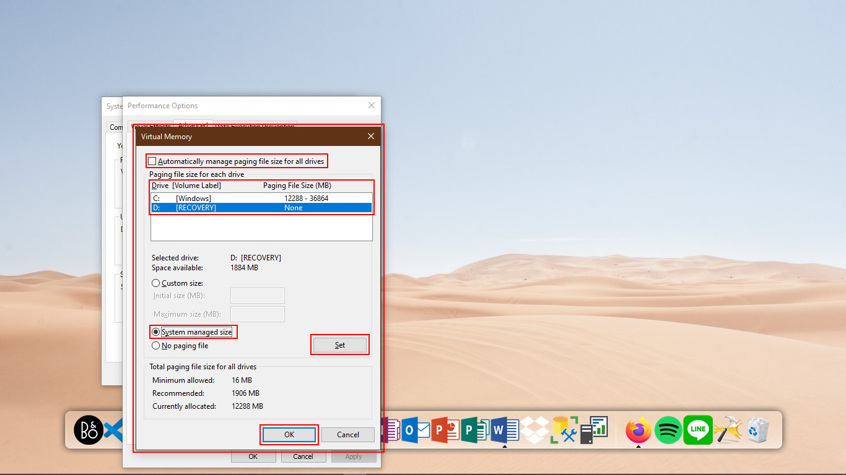
6
Notes:
Select the new location for page file and select System managed size button and click the Set button and OK button. Close all tab and restart the computer

Slide 24
The Function Of Virtual Memory
Notes:
> Fadhal

Slide 25
Handle the excess load of RAM
Becomes a backup RAM, but does not replace the RAM function.
Saves data from RAM, but not transferred to the processor
Data that stored in virtual memory (paging file) is temporary
Notes:
1 If a computer with 2.0 GB RAM and want to store 2.3 GB data, the computer certainly hang, lag, or will be not respond at all. VM plays an active role to handle the excess and the VM capacity is taken from the hard disk capacity.
2 Becomes a backup RAM, but does not replace the RAM function
In general RAM functions is to store data that will be processed by the processor or data from running activities. If there are Virtual Memory, it does not mean the computer does not need the RAM and can run the activity in the absence of RAM installed on a computer.
3 Christ
4 Christ

Slide 26
Conclusion
From this ISAS, we can conclude that virtual memory still become one of the most important in computer system, although many user do not want to know or understand more about virtual memory.
Notes:
>

Slide 27
Suggestion
From this ISAS, we can suggest anyone who uses computer to know more and try to start thinking that virtual memory is one from many important things or part that need to exist in our computer system.
Notes:
>

Slide 28
THANK YOU
THANK YOU

